Slide 1
Hadoop Distributed File system
Dr. Hassan Tariq

Slide 2
Introduction
The Hadoop Distributed File System (HDFS) is a distributed file system designed to run on commodity hardware.
It has many similarities with existing distributed file systems. However, the differences from other distributed file systems are significant.
HDFS is highly fault-tolerant and is designed to be deployed on low-cost hardware.
HDFS provides high throughput access to application data and is suitable for applications that have large data sets.
HDFS is part of the Apache Hadoop Core project. The project URL is http://hadoop.apache.org/

Slide 3
NameNode and DataNodes
HDFS has a master/slave architecture.
An HDFS cluster consists of a single NameNode, a master server that manages the file system namespace and regulates access to files by clients.
In addition, there are a number of DataNodes, usually one per node in the cluster, which manage storage attached to the nodes that they run on.
HDFS exposes a file system namespace and allows user data to be stored in files.

Slide 4
NameNode and DataNodes
Internally, a file is split into one or more blocks and these blocks are stored in a set of DataNodes.
The NameNode executes file system namespace operations like opening, closing, and renaming files and directories.
It also determines the mapping of blocks to DataNodes.
The DataNodes are responsible for serving read and write requests from the file system’s clients.
The DataNodes also perform block creation, deletion, and replication upon instruction from the NameNode.

Slide 5
NameNode and DataNodes
The NameNode and DataNode are pieces of software designed to run on commodity machines.
These machines typically run a GNU/Linux operating system (OS).
HDFS is built using the Java language; any machine that supports Java can run the NameNode or the DataNode software.
Usage of the highly portable Java language means that HDFS can be deployed on a wide range of machines.
A typical deployment has a dedicated machine that runs only the NameNode software.

Slide 6
NameNode and DataNodes
Each of the other machines in the cluster runs one instance of the DataNode software.
The architecture does not preclude running multiple DataNodes on the same machine but in a real deployment that is rarely the case.
The existence of a single NameNode in a cluster greatly simplifies the architecture of the system. The NameNode is the arbitrator and repository for all HDFS metadata.
The system is designed in such a way that user data never flows through the NameNode.

Slide 7


Slide 8
The File System Namespace
HDFS supports a traditional hierarchical file organization.
A user or an application can create directories and store files inside these directories.
The file system namespace hierarchy is similar to most other existing file systems; one can create and remove files, move a file from one directory to another, or rename a file.
HDFS supports user quotas and access permissions.
HDFS does not support hard links or soft links. However, the HDFS architecture does not preclude implementing these features.

Slide 9
The File System Namespace
The NameNode maintains the file system namespace.
Any change to the file system namespace or its properties is recorded by the NameNode.
An application can specify the number of replicas of a file that should be maintained by HDFS.
The number of copies of a file is called the replication factor of that file. This information is stored by the NameNode.

Slide 10
Data Replication
HDFS is designed to reliably store very large files across machines in a large cluster.
It stores each file as a sequence of blocks. T
he blocks of a file are replicated for fault tolerance.
The block size and replication factor are configurable per file.
All blocks in a file except the last block are the same size, while users can start a new block without filling out the last block to the configured block size after the support for variable length block was added to append and hsync.

Slide 11
An application can specify the number of replicas of a file.
The replication factor can be specified at file creation time and can be changed later.
Files in HDFS are write-once (except for appends and truncates) and have strictly one writer at any time.
The NameNode makes all decisions regarding replication of blocks.
It periodically receives a Heartbeat and a Blockreport from each of the DataNodes in the cluster.
Receipt of a Heartbeat implies that the DataNode is functioning properly.
A Blockreport contains a list of all blocks on a DataNode.

Slide 12
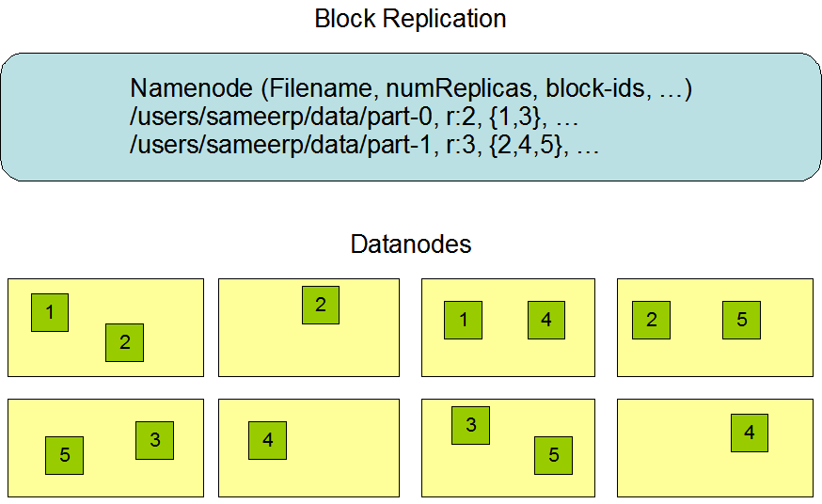

Slide 13
Replica placement
Optimizing replica placement distinguishes HDFS from most other distributed file systems.
This is a feature that needs lots of tuning and experience. The purpose of a rack-aware replica placement policy is to improve data reliability, availability, and network bandwidth utilization.
The NameNode determines the rack id each DataNode belongs to via the process outlined in Hadoop Rack Awareness.
A simple but non-optimal policy is to place replicas on unique racks. This prevents losing data when an entire rack fails and allows use of bandwidth from multiple racks when reading data.
This policy evenly distributes replicas in the cluster which makes it easy to balance load on component failure. However, this policy increases the cost of writes because a write needs to transfer blocks to multiple racks.

Slide 14
What is a rack?
The Rack is the collection of around 40-50 DataNodes connected using the same network switch.
If the network goes down, the whole rack will be unavailable.
A large Hadoop cluster is deployed in multiple racks.

Slide 15
What is Rack Awareness in Hadoop HDFS?
To reduce the network traffic during file read/write, NameNode chooses the closest DataNode for serving the client read/write request.
NameNode maintains rack ids of each DataNode to achieve this rack information.
This concept of choosing the closest DataNode based on the rack information is known as Rack Awareness.
For the common case, when the replication factor is three, HDFS’s placement policy is to put one replica on the local machine if the writer is on a datanode, otherwise on a random datanode in the same rack as that of the writer, another replica on a node in a different (remote) rack, and the last on a different node in the same remote rack.

Slide 16
Rack awareness policies says:
Not more than one replica be placed on one node.
Not more than two replicas are placed on the same rack.
Also, the number of racks used for block replication should always be smaller than the number of replicas.

Slide 17
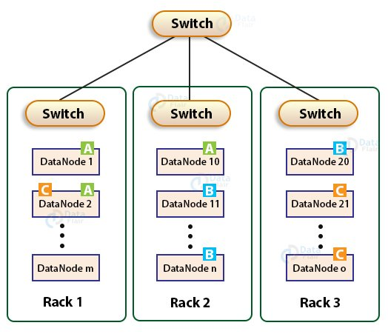

Slide 18
Why Rack Awareness?
To reduce the network traffic while file read/write, which improves the cluster performance.
To achieve fault tolerance, even when the rack goes down (discussed later in this article).
Achieve high availability of data so that data is available even in unfavorable conditions.
To reduce the latency, that is, to make the file read/write operations done with lower delay.

Slide 19
Map Reduce Programming

Slide 20
MapReduce is a framework using which we can write applications to process huge amounts of data, in parallel, on large clusters of commodity hardware in a reliable manner.
MapReduce is a processing technique and a program model for distributed computing based on java.

Slide 21
The MapReduce algorithm contains two important tasks, namely Map and Reduce.
Map takes a set of data and converts it into another set of data, where individual elements are broken down into tuples (key/value pairs).
Secondly, reduce task, which takes the output from a map as an input and combines those data tuples into a smaller set of tuples.
The major advantage of MapReduce is that it is easy to scale data processing over multiple computing nodes.

Slide 22
Hadoop is capable of running MapReduce programs written in various languages: Java, Ruby, Python, and C++.
The programs of Map Reduce in cloud computing are parallel in nature, thus are very useful for performing large-scale data analysis using multiple machines in the cluster.
The input to each phase is key-value pairs. In addition, every programmer needs to specify two functions: map function and reduce function.

Slide 23
Working
The whole process goes through four phases of execution namely, splitting, mapping, shuffling, and reducing.
Consider you have following input data for your MapReduce in Big data Program
Welcome to Hadoop Class Hadoop is good Hadoop is bad

Slide 24
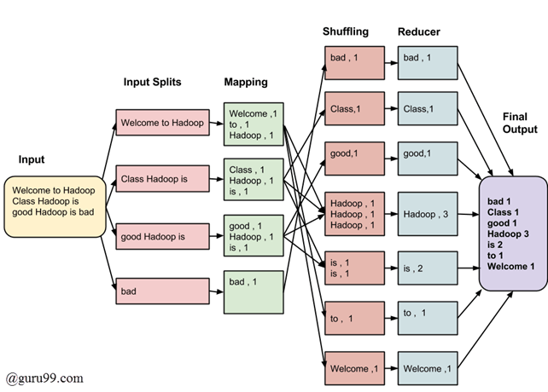

Slide 25
The data goes through the following phases of MapReduce in Big Data
Input Splits:
An input to a MapReduce in Big Data job is divided into fixed-size pieces called input splits Input split is a chunk of the input that is consumed by a single map

Slide 27
Mapping
This is the very first phase in the execution of map-reduce program.
In this phase data in each split is passed to a mapping function to produce output values.
In our example, a job of mapping phase is to count a number of occurrences of each word from input splits and prepare a list in the form of <word, frequency>

Slide 29
Shuffling
This phase consumes the output of Mapping phase.
Its task is to consolidate the relevant records from Mapping phase output.
In our example, the same words are clubed together along with their respective frequency.

Slide 31
Reducing
In this phase, output values from the Shuffling phase are aggregated.
This phase combines values from Shuffling phase and returns a single output value. In short, this phase summarizes the complete dataset.
In our example, this phase aggregates the values from Shuffling phase i.e., calculates total occurrences of each word.

Slide 33
MapReduce Architecture explained
One map task is created for each split which then executes map function for each record in the split.
It is always beneficial to have multiple splits because the time taken to process a split is small as compared to the time taken for processing of the whole input. When the splits are smaller, the processing is better to load balanced since we are processing the splits in parallel.

Slide 34
However, it is also not desirable to have splits too small in size. When splits are too small, the overload of managing the splits and map task creation begins to dominate the total job execution time.
For most jobs, it is better to make a split size equal to the size of an HDFS block (which is 64 MB, by default).
Execution of map tasks results into writing output to a local disk on the respective node and not to HDFS.

Slide 35
Reason for choosing local disk over HDFS is, to avoid replication which takes place in case of HDFS store operation.
Map output is intermediate output which is processed by reduce tasks to produce the final output.
Once the job is complete, the map output can be thrown away. So, storing it in HDFS with replication becomes overkill.
In the event of node failure, before the map output is consumed by the reduce task, Hadoop reruns the map task on another node and re-creates the map output.

Slide 36
Reduce task doesn’t work on the concept of data locality. An output of every map task is fed to the reduce task. Map output is transferred to the machine where reduce task is running.
On this machine, the output is merged and then passed to the user-defined reduce function.
Unlike the map output, reduce output is stored in HDFS (the first replica is stored on the local node and other replicas are stored on off-rack nodes). So, writing the reduce output

